Slide 1
CITS4404 Project:
Ai vs Wally
Group members:
Vladislav Matveev - 21965049
Dickson Hee - 21900505
Terence Leong - 21707741

Slide 2
Introduction
Computer Vision:
Concerned with object detection and pattern recognition
End-goal of making computers ‘see like we see’
AI must not only be able to ‘see’ an object but must also be able to understand the contents of the image

Slide 3
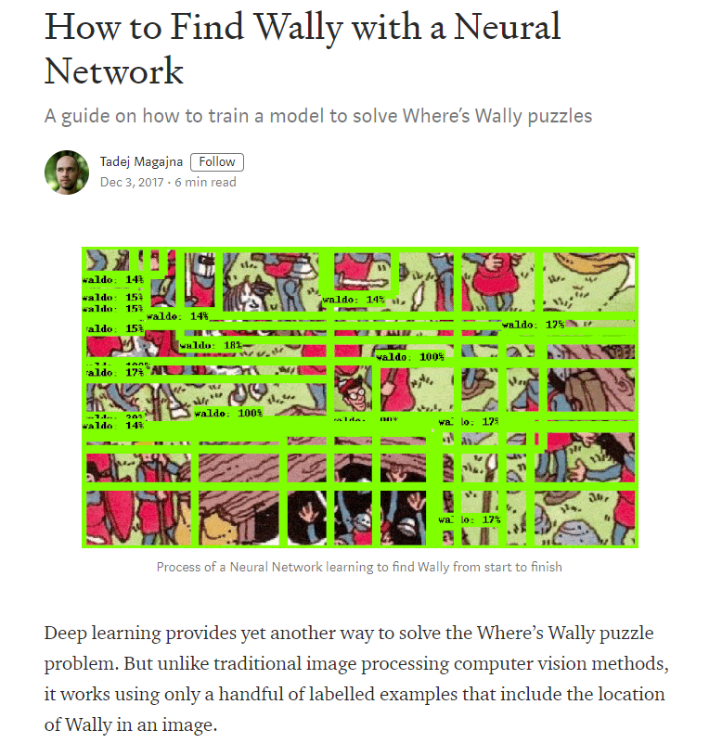
Recap from the project proposal
Finding Wally presented several challenges:
The target (Wally) varies in size (a scaling issue)
Images have repeating patterns of differing significance (red & white stripes present on other objects)
There is occlusion (where Wally is partially blocked from view by other scene objects)

Slide 4
Objectives
First objective - creating a neural network capable of consistently detecting Wally's location
Second objective - track the effectiveness of the developed system
Third objective - come up with a variety of practical uses for this system, that could potentially be developed in the future

Slide 5
Background information
RCNN
Region-based Convolutional Neural Network, the main model used during development
Transfer learning
Increasing learning speed by introducing a pre-trained model to improve upon
Hey-Waldo repository:
~6500 ‘.jpg’ image entries, black & white + colour, divided into training/testing as needed
COCO dataset
‘Common Objects in Context’ Dataset, used for object detection as well as object annotation

Slide 6
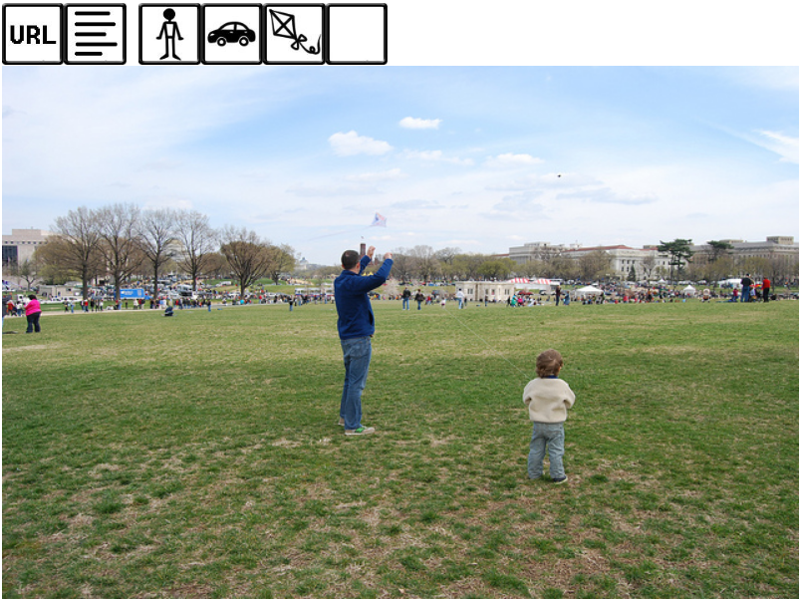
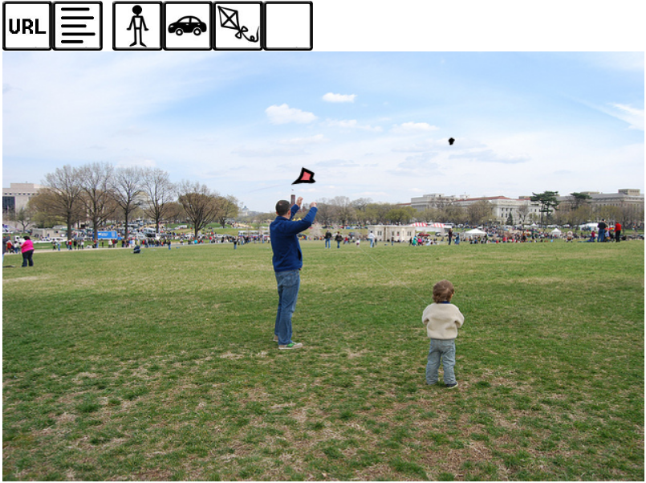
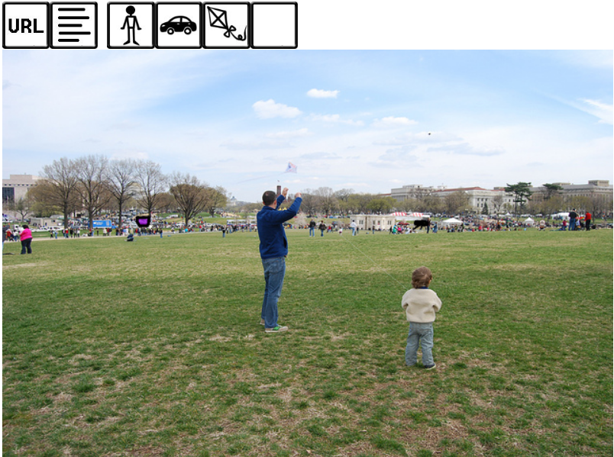
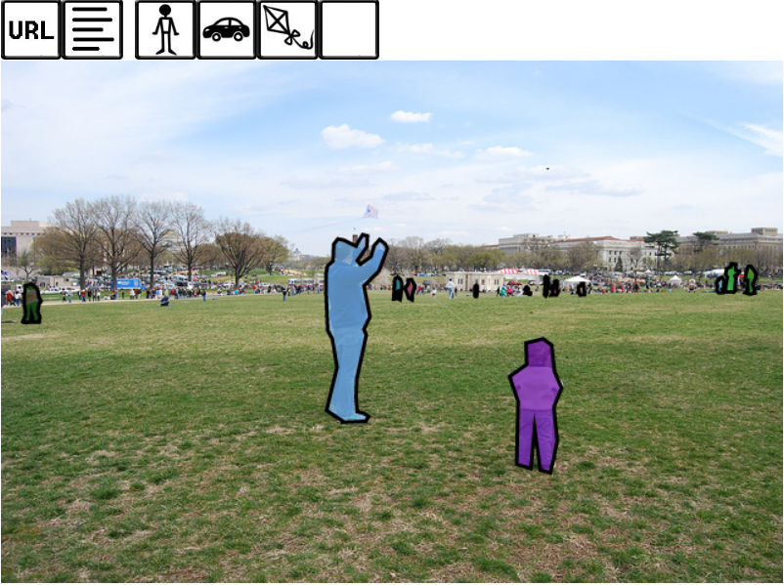
Showcase of the COCO dataset
The dataset provides useful annotations for teaching AI to distinguish objects
The images show:
‘Hide annotations’
‘Kite’
‘Car’
‘Person’
Even the smaller details are annotated, which would allow for a higher degree of accuracy

Slide 7
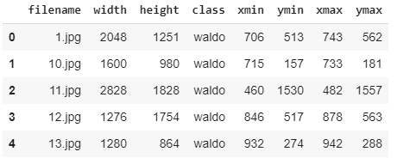
Preparing the Dataset
Ensure training data is formatted and prepared
Training data consist of images and set of locations for Waldo
Packaged into .tfrecord file

Slide 8

Preparing the Model
Apply transfer learning to solve our problem
Steps taken:
Clone Tensorflow Model Repository
Clone COCO Object Detection API
Compile model definition
Test the API
Replace checkpoint file .tfrecord file and label maps file

Slide 9
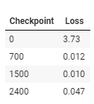
Training Phase
Loss of information is important
Checkpoints are saved for restoration
Loss is calculated every 100 steps
Takes approximately 2 minutes every 100 steps

Slide 10
Testing Phase
Steps for testing:
Import an inference graph from a stored checkpoint from training phase
Use Python script based on Tensorflow Object Detection API on models and draw boxes around Wally
Overall, our trained model was able to locate Wally without much issue.

Slide 11
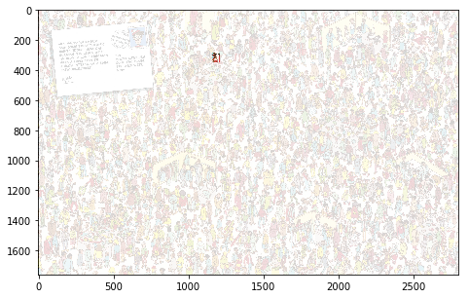

Results

Slide 12
Conclusion
Our model managed to successfully find Wally in a test image
Larger samples of Wally required to increase robustness
Main difficulties are determining the appropriate files required to run the model
Running the training algorithm for too long might cause overfitting, therefore should stop training at around 0.1% loss
Overall, reached an efficient solution that found Wally
Research on different types of CNNs such as YOLO or Faster-RCNN should be done to reduce training time.

Slide 13
Future Work
Searching of missing people through image analysis:
Millions of pictures are taken each day and posted online
Self-driving cars also using cameras for autonomous driving
Millions of surveillance cameras in the world
It should be possible for an improved method to consistently and efficiently locate missing people autonomously.
Could attempt to use YOLO or Faster-RCNN
Some issues would include the complexity of human faces, quality of images procured, speed and accuracy of detection.

Slide 14
Future Work
Automated CCTV:
Large amount of space required to store all recorded data
Can be configured to only record when a particular object or person has been detected or skim through the footage and save only when necessary
Able to track movement of object/person within the frame
Some limitations include the detection speed of the model and the accuracy of detection.
Accuracy can be increased through some supervised learning i.e. a person reviewing the footage can provide some feedback

Slide 15
Thanks for listening
Questions?

